Slide 1
Introduction
SURP 2022 Python Bootcamp
Ohio State Astronomy
Slides by: James W. Johnson

Slide 2
Hello!
Fifth/Sixth year PhD student in the Astronomy Department
Research Interests
Galactic chemical evolution (David Weinberg, Jennifer Johnson)
[Type Ia] Supernovae (Chris Kochanek, Kris Stanek)
Previously: dark matter halos and their environments
Versatile Integrator for Chemical Evolution (VICE: https://pypi.org/project/vice)
~89,200 lines (Python & C) in latest release (1.3.0) supporting Python >= 3.6.
We’ll do a mix of slides and exercises – I won’t be collecting and grading anything. This isn’t a course. What you get out of this will reflect what you put into it.

Slide 3
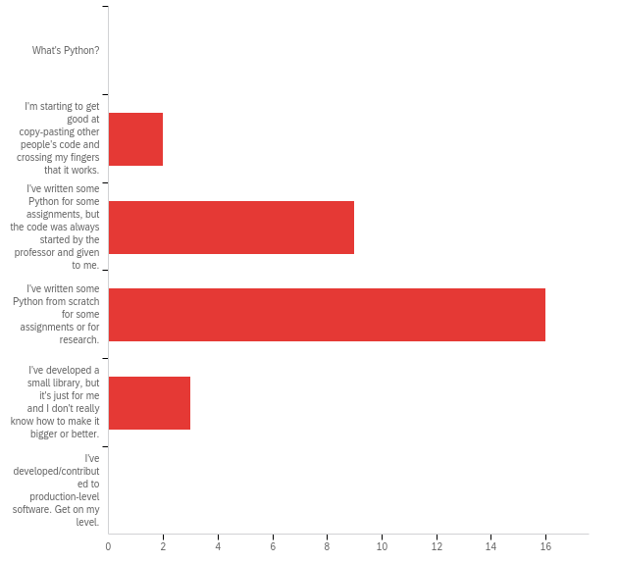
Survey Responses
Q1: How would you describe your skill level in Python?
A wide range of skills – some quite new, some have made small libraries
We’re aiming to get you up to the second-to-last option

Slide 4
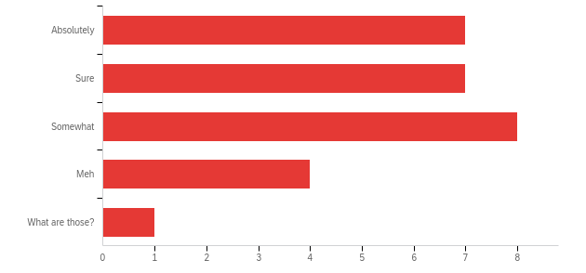
Survey Responses
Q2: Are you comfortable with if/else conditions, for- and while-loops, and def statements?
A wide range of skills in functional programming

Slide 5
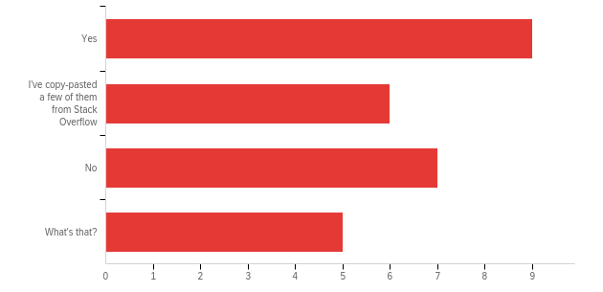
Survey Responses
Q3: Have you ever written a class?
Many of you have, many of you haven’t
This will be the focus of sessions 4 and 5

Slide 6
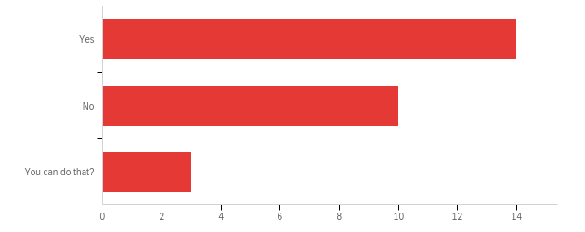
Survey Responses
Q4: Do you know how to, or have you already imported your own code from another file?
Many of you have, many of you haven’t

Slide 7
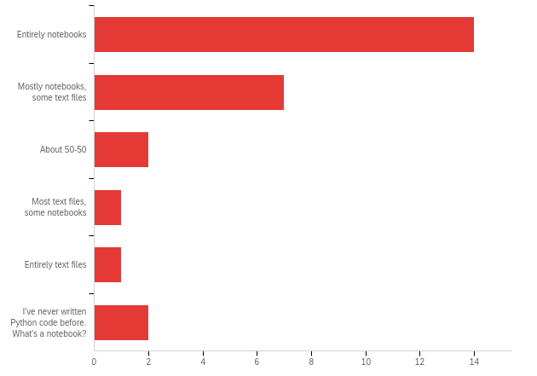
Survey Responses
Q5: Do you write code in text files or jupyter notebooks (or some equivalent)?
A wide range of preferences for your programming medium. Those who have received code from instructors probably ran it on SciServer, which uses notebooks

Slide 8
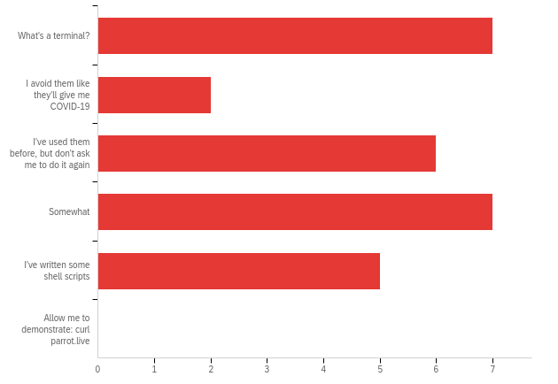
Survey Responses
Q6: How comfortable are you using a terminal/command-line?
Some of you have never used them, others are rather experienced

Slide 9
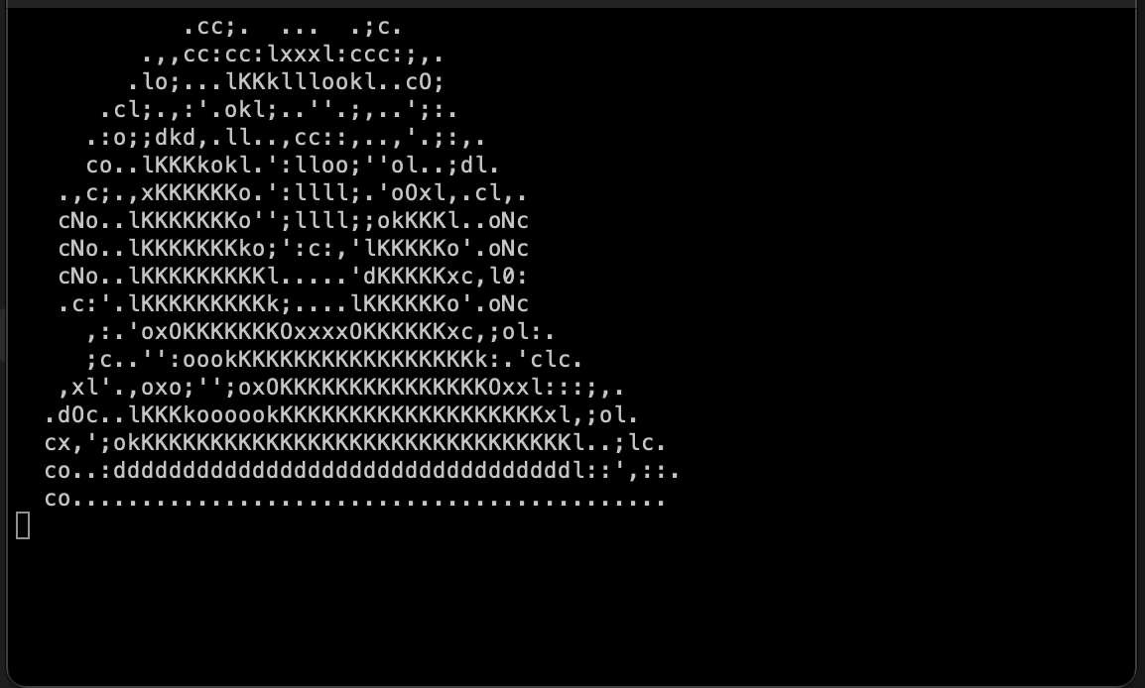
Survey Responses
Q6: How comfortable are you using a terminal/command-line?
Some of you have never used them, others are rather experienced

Slide 10
Survey Responses
New material:
For many of you: the terminal
For about half of you:
How to import your own code from elsewhere in your computer (packaging may be new to some)
Object oriented programming (some of the material may still be new)
Some of the material is either impossible or quite difficult when coding in a notebook. I advise all of you to use this bootcamp as practice for working in text files.
A few of you are students from last year’s SURP program who have already gone through this bootcamp – come talk to me if you’d like to go beyond this material!
Notes:
In particular, if there are students who successfully implemented the deck of cards last year and are still comfortable with this level of programming, they should talk to me after this session. In short, the best thing they can do is pick up some knowledge of a compiled language. I would recommend C or C++.

Slide 11
Survey Responses
New material:
For many of you: the terminal
For about half of you:
How to import your own code from elsewhere in your computer (packaging may be new to some)
Object oriented programming (some of the material may still be new)
Some of the material is either impossible or quite difficult when coding in a notebook. I advise all of you to use this bootcamp as practice for working in text files.
Those of you new to Python – Wednesday is going to be a crash course. I’d strongly advise going through some of the additional beginner-level material linked on GitHub
Notes:
I’ll show them how to download the course material after we talk about terminal commands.

Slide 12
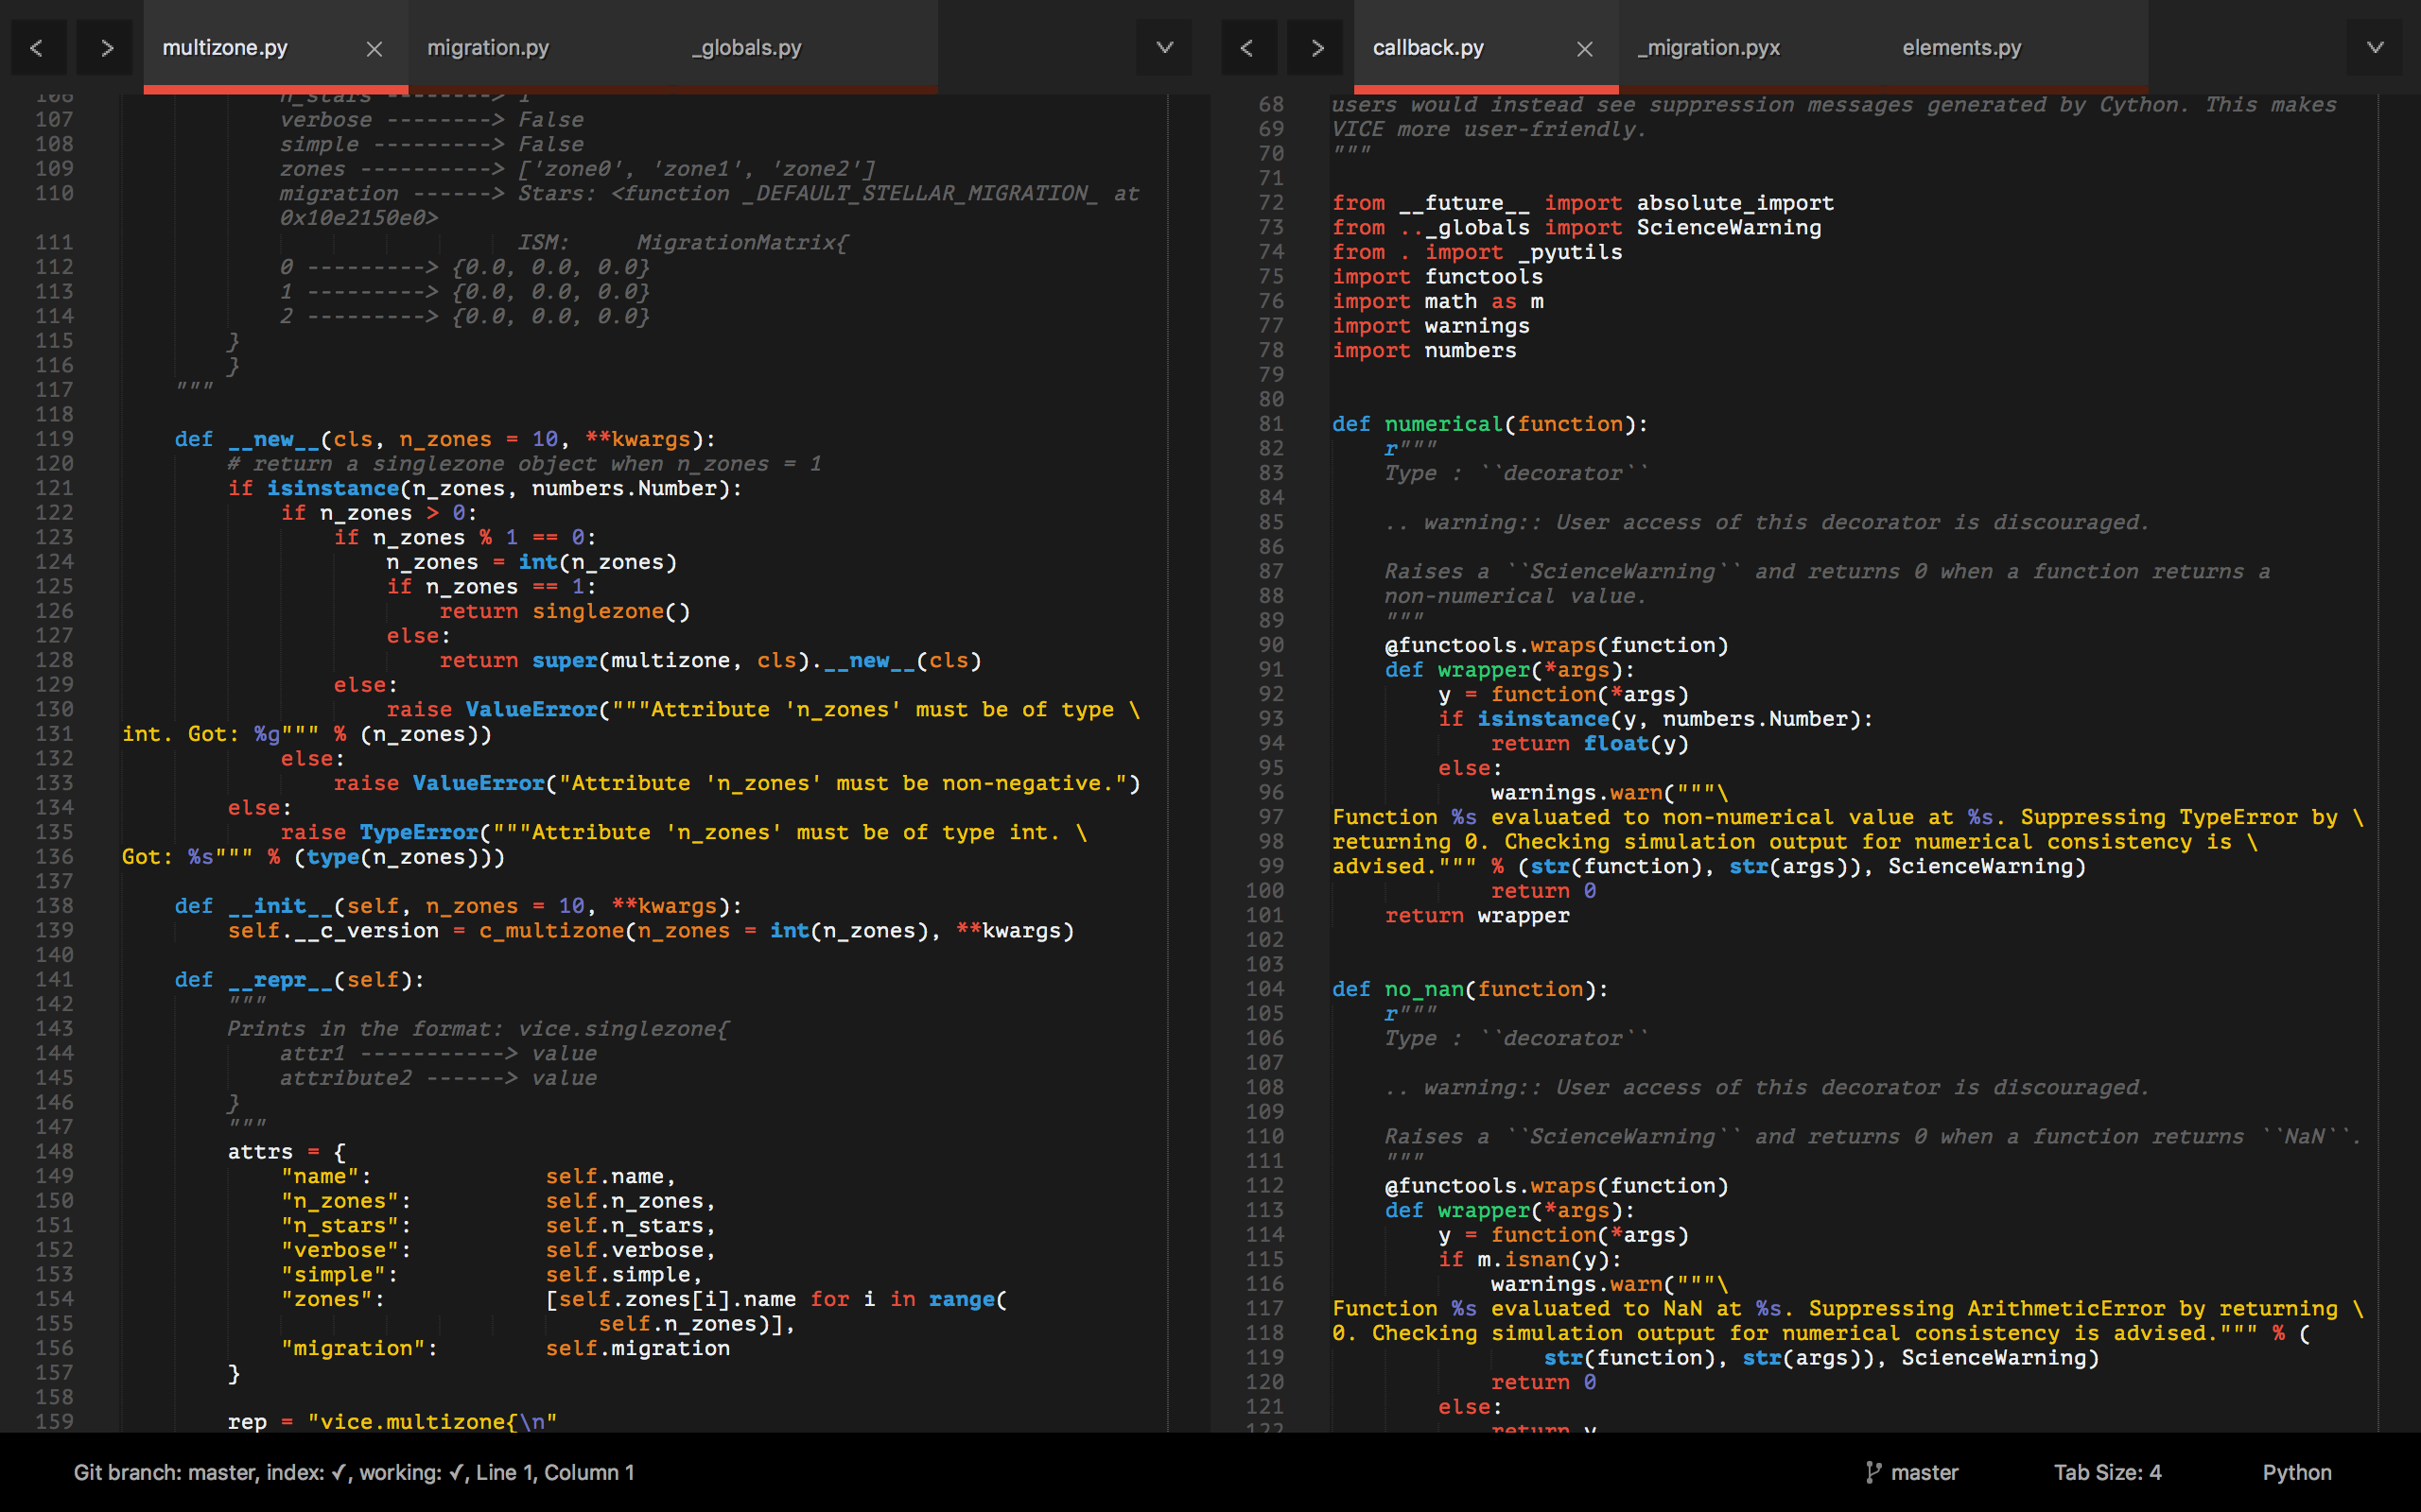
Tools: A Text Editor
Differs from an Integrated Development Environment (IDE) in that IDEs will run the code – all they do is open, create, edit, etc. plain text files
pycharm, spyder
I recommend Sublime Text
https://www.sublimetext.com/

Slide 13
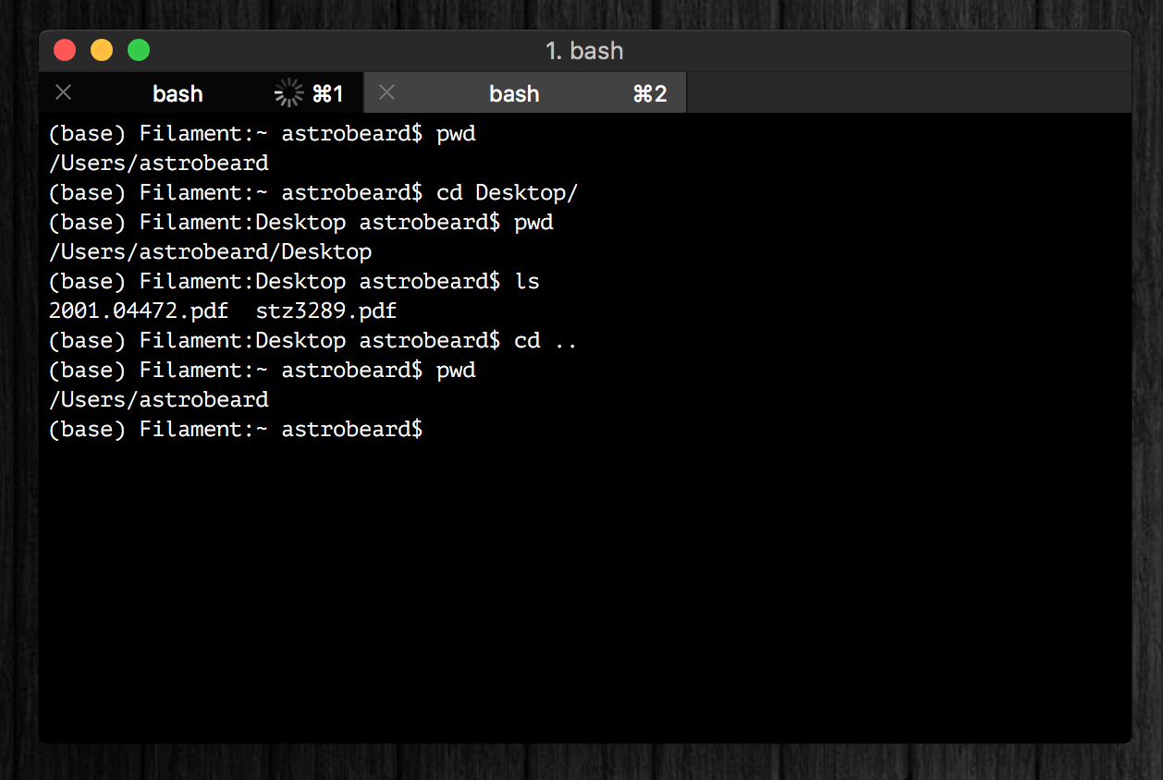
Tools: A Terminal
I recommand iTerm2
Terminal replacement
https://www.iterm2.com/
You should think of a terminal as just a different interface on a Finder window with some extra programs built-in
Tip: you can run python line-by-line in a terminal (python or ipython)

Slide 14
Tools: A Terminal
If you’re running Windows, your terminal will be different than some of the notes and exercises here, unless you take some extra steps at the beginning to set up a bash interpreter.
Talk to me if you need help with this!

Slide 15
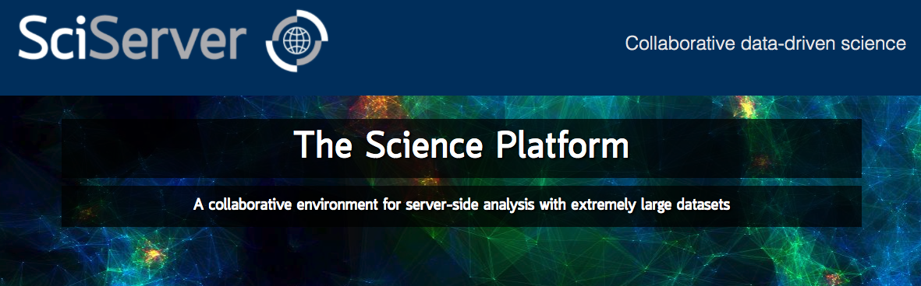
Tools: Cloud Computing
Allows you to run python on a remote server
SciServer is a popular platform across many STEM fields:
https://www.sciserver.org/
In the long run you should choose the tools that you’re most comfortable with

Slide 16
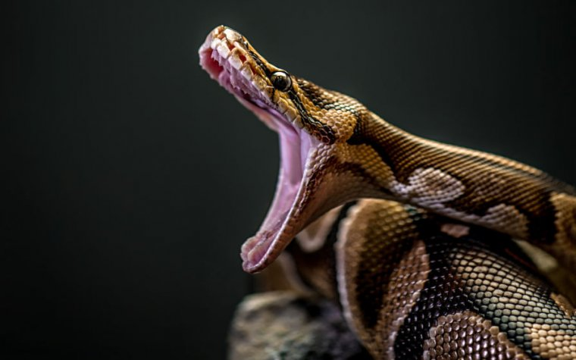
If You Haven’t Already
https://www.anaconda.com/products/individual
This will install Python, Anaconda, and Jupyter Notebooks
Latest version of python: 3.10.4
Most libraries now require >= 3.7
NumPy’s latest version requires >= 3.8
Python 2.7 is deprecated

Slide 17
Other Resources
Python Foundation’s Beginner’s Guide: https://www.python.org/about/gettingstarted/
https://www.learnpython.org/ - There is also an iOS app for this
Codecademy: https://www.codecademy.com/learn/learn-python-3

Slide 18
Goals
What we’ll aim to cover:
How to use a terminal
Review of the basics: control structures, data types, functions, import, etc.
How to read documentation
How to import your own code, and how to set up a directory tree to organize it
Classes: how to make new objects
Inheritance and Composition
Some basic software engineering principles (i.e. good habits)

Slide 19
Monday Motivation
Every expert coder was once a novice.
You can’t improve your coding practices without first criticizing what you once thought was great code.
Since we’re not professional developers, scientists have to actively create and foster good coding habits if they want them. Being early career researchers, you have the option to make this decision now. It will only become more difficult to do this.

